Slide 1
Introduction to AngularJS
JavaScript: Road to AngularJS
Class-3
Jubayer Al Farabi

Slide 2
AngularJS
Library
Framework
What is AngularJS? (MV*)
AngularJs is a Framework and Library also.
Architect your application instead of design a page
Don’t augment jQuery with AngularJs
Always think in terms of Architecture
What is Single Page Application ?
This is application not just bunch of web pages !!

Slide 3

How AngularJS Works
MVC

Slide 4
Think in AngularJs !
Declarative Approach
<div class="main-menu" dropdown-menu ng-cloak> ... </div>
This is called Declarative approach
Here ‘dropdown-menu’ and ‘ng-cloak’ are Directives
Directive
This is place where you can manipulate your Markup.
Remember: don't design, and then mark up. You must architect, and then design.

Slide 5
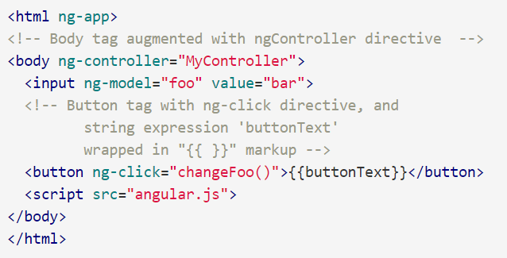
AngularJs component
AngularJs Template
In a simple app, the template consists of HTML, CSS, and Angular directives contained in just one HTML file (usually index.html).

Slide 6
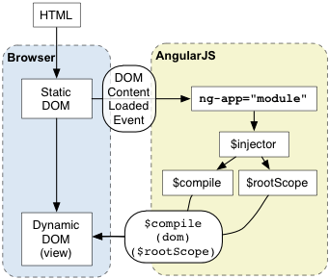
AngularJs Bootstrap
Automatic Initialization
upon DOMContentLoaded event or when the angular.js script is evaluated if at that time document.readyState is set to'complete’ ,looks for ng-app directive
load the module associated with the directive.
create the application injector
compile the DOM treating the ngApp directive as the root of the compilation.

Slide 7
AngularJs component
MODULE: A container for the different parts of your app – controllers, services, filters, directives, etc.
You can package code as reusable modules.
The modules can be loaded in any order (or even in parallel) because modules delay execution.
Unit tests only have to load relevant modules, which keeps them fast.

Slide 8
AngularJs component
View Model
Distinct model layer
scope is an object that refers to the application model
$scope.countries = ['can', 'usa', 'fra', 'jap'];
$scope.user = {name: "Evil Trout"};

Slide 9
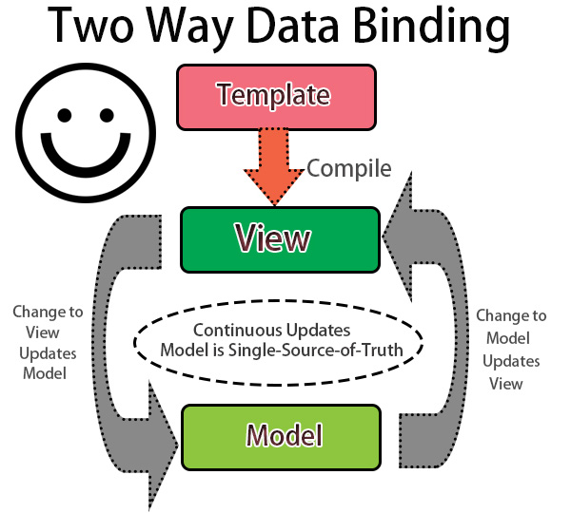
AngularJs component
Data Binding

Slide 10
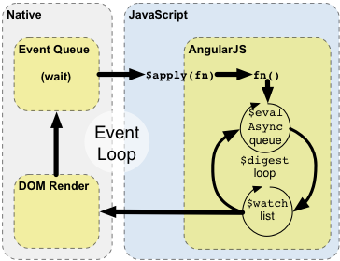
AngularJs component
Data Binding Under the hood
Notes:
The browser's event-loop waits for an event to arrive. The event's callback gets executed... Once the callback executes, the browser leaves the JavaScript context and re-renders the view based on DOM changes. Angular modifies the normal JavaScript flow by providing its own event processing loop. This splits the JavaScript into classical and Angular execution context... Angular executes [some] stimulusFn(), which typically modifies application state. Angular enters the $digest loop. The loop is made up of two smaller loops which process $evalAsync queue and the $watch list. The $digest loop keeps iterating until the model stabilizes, which means that the $evalAsync queue is empty and the $watch list does not detect any changes. The $watch list is a set of expressions which may have changed since last iteration. If a change is detected then the $watch function is called which typically updates the DOM with the new value.

Slide 11
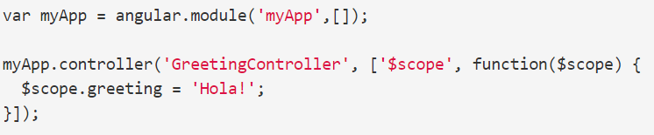
AngularJs component
Controllers
A Controller is a JavaScript constructor function that is used to augment the Angular Scope
A Controller is attached to the DOM via the ng-controller directive

Slide 12
AngularJs component
Use controllers to:
Set up the initial state of the $scope object.
Add behavior to the $scope object.
Do not use controllers to:
Manipulate DOM
Format input — Use angular form controls instead.
Filter output — Use angular filters instead.
Share code or state across controllers — Use angular services instead.
Manage the life-cycle of other components (for example, to create service instances).

Slide 13
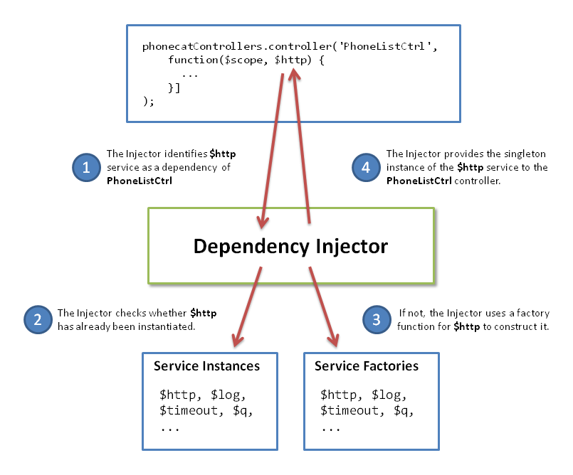
AngularJs component
DI

Slide 14
AngularJs component
Services
Lazily instantiated
Singletons
Types
Factories
Value
Constant
Service
Provider

Slide 15
AngularJs component
Directives
Directives are markers on a DOM element (such as an attribute, element name, comment or CSS class) that tell AngularJS'sHTML compiler ($compile) to attach a specified behavior to that DOM element or even transform the DOM element and its children.
<input ng-model="foo">
<input data-ng:model="foo">

Slide 16



AngularJs component
Filters
A filter formats the value of an expression for display to the user

